Slide 1
The broad RI ecosystem
Research Infrastructures in a Changing Global, Environmental and Socio-economical Context Belgian Presidency of the European Council
Brussels, June 5th, 2024
José Luis Martínez Peña
ESFRI Chair

Slide 2
European Spallation Source, Lund (Sweden)
ESFRI Vision:
Equipping Europe with infrastructures for ground-breaking research

Slide 3
Introduction
01
The European Strategy Forum on Research Infrastructures (ESFRI) plays a crucial role as a policy advisory body within the European Union.
ESFRI was established in 2002 to develop a coherent and strategy-driven approach to research infrastructures (RI) in Europe.
02
ESFRI acts as a central platform for strategic thinking and collaboration, guiding the development of research infrastructures in Europe and contributing to the region's competitiveness in the global scientific landscape.

Slide 4
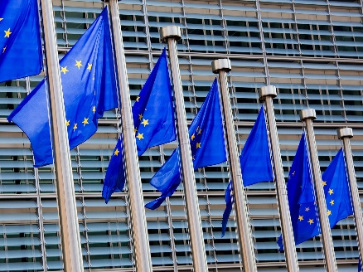
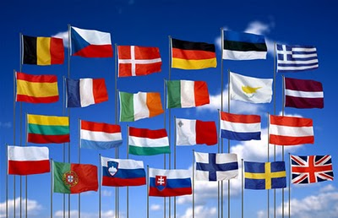
Forum of the MS/AC with the EC to select new projects of RI (RoadMap).
Priority are the Pan-European RI of Excellent quality. To coordinate the interests of the MS/AC in a variable geometry approach
Using the Work Program of Horizon Europe to finance specific aspects of RIs, as well as the Structural Funds (DG- Regio)
ESFRI
EC
To engage national financial compromises for the construction and long term operation of the RI
MS/AC

Slide 5
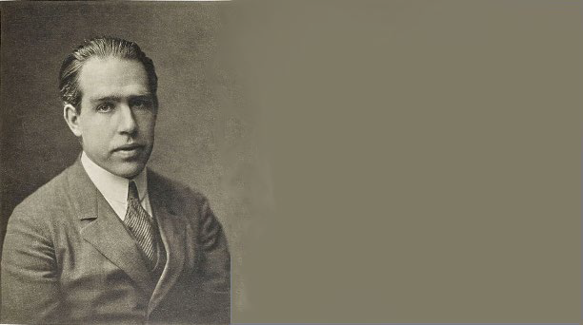
The time-line of the different actors is very important and should be taken into account:
The User
2 - 4 years
Prediction is very difficult, especially about the future
Niels Bohr
The RI Management
10 - 12 years
The Ministry/Research Agency
40 - 50 years
How to take decisions in this wide “dynamical range”?
Notes:
Impacto a lo largo del tiempo para los distintos actores de grandes instalaciones científicas

Slide 6
ESFRI´s Policy Advisory Role
Collaboration with national governments and the European Commision
Strategic approach to ensure the openness and accessibility of world-class sustainable RI for researchers in Europe
Analysing the Landscape of RI
Monitoring RI performance
Updating the ESFRI Roadmap to identify and prioritize research infrastructures of strategic importance

Slide 7
ESFRI – Additional active working groups
Drafting Group on RI funding
Including synergies with national and regional funding, EU and others
Drafting Group on international cooperation
Drafting Group on resilience and greening of RIs
Drafting Group on Stakeholder engagement
SH Forum and meetup
EOSC-ESFRI collaboration
Industrial cooperation and collaboration with TIs

Slide 8
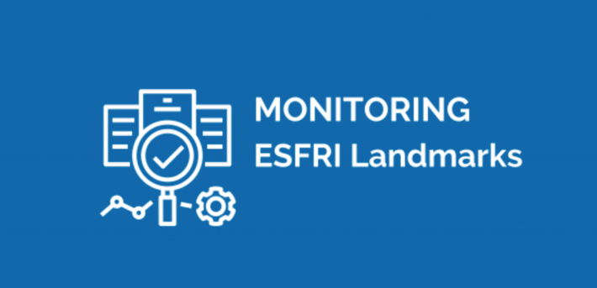
ESFRI – continuous activities
Landscape analysis - Since 2016, it provides an overview of the European RI ecosystem. Gelsomina Pappalardo
ESFRI Roadmap - a strategic document that identifies and prioritizes major research infrastructures of pan-European importance.
ESFRI monitoring - guaranteeing the excellence of the Landmark label.
(first report available from the ESFRI website)

Slide 9
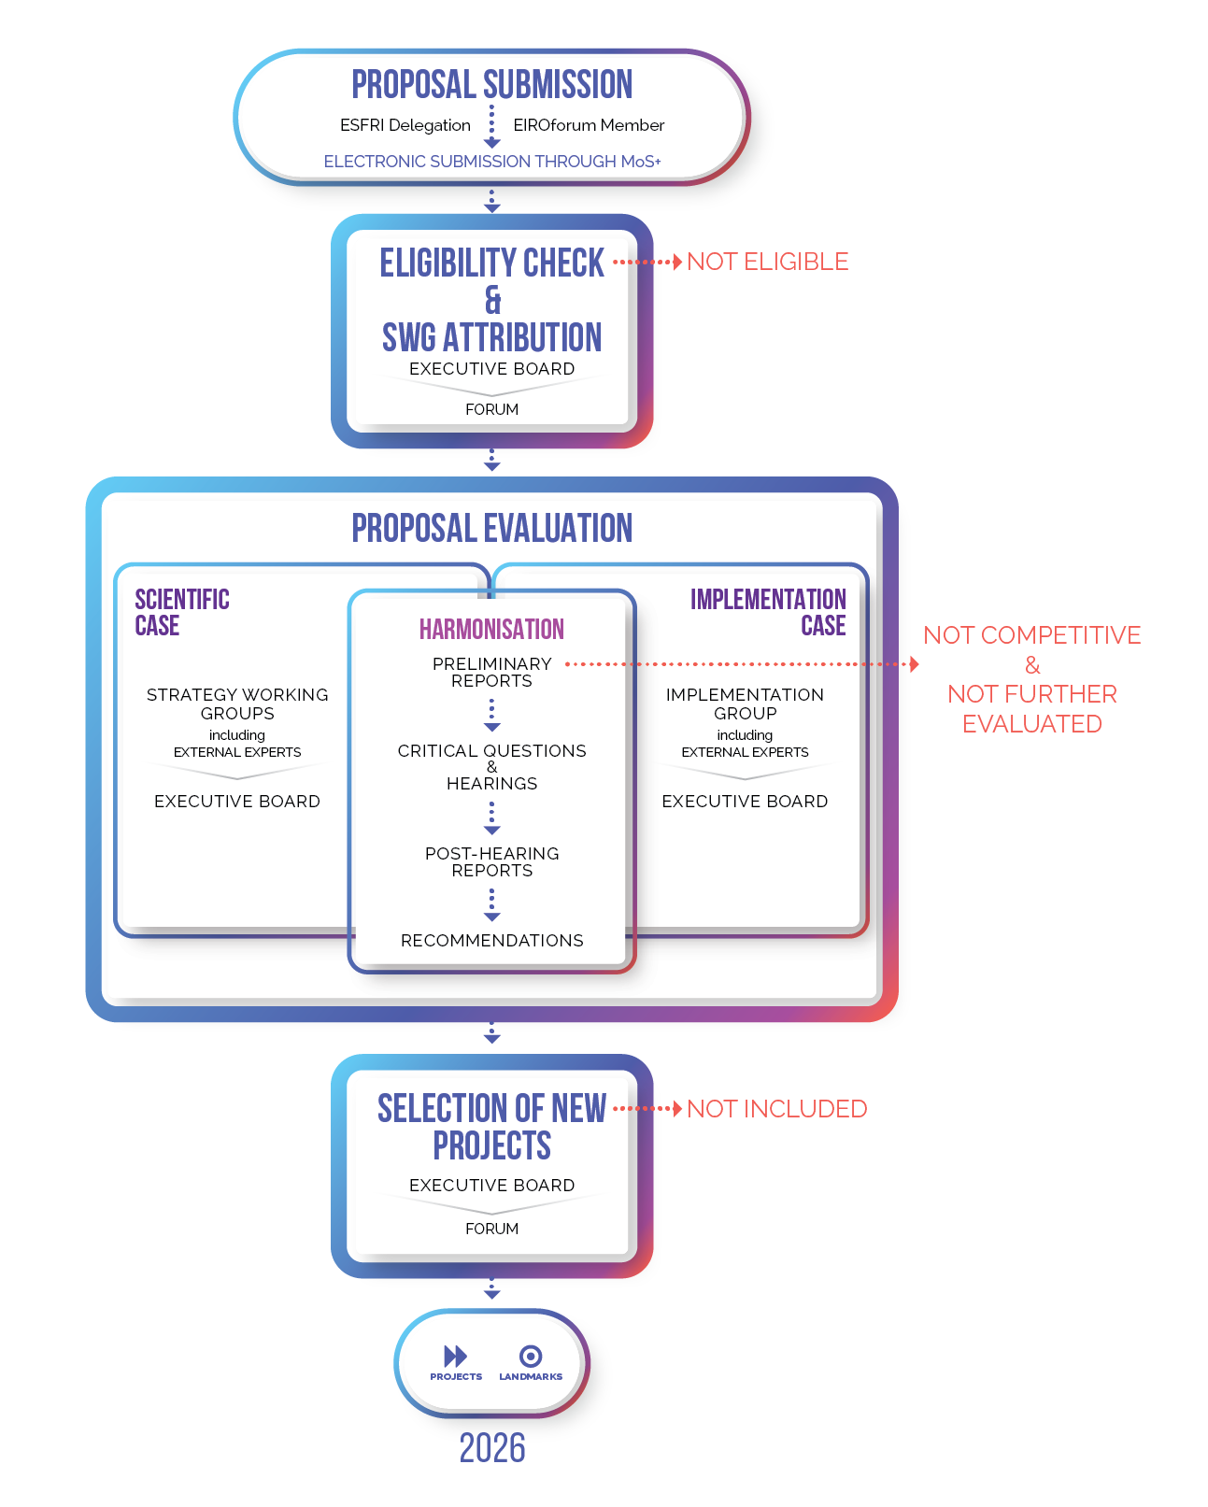
Roadmap 2026
Monitoring of the ESFRI Landmarks already in process
To remove projects not implemented in the last 10 years
Info-day expected October 8th, 2024 in Brussels
A public call for NEW projects of RI (Oct 8th 2024 – Early April 2025)
To evaluate the new propositions along 2025 and to present the new ESFRI Roadmap by second half of 2026

Slide 10
Monitoring
Monitoring allows insights in the functioning of the RI Ecosystem
Aims to collect and analyze data on activities and outputs to assess progress towards predetermined goals.
Supports RIs with the Key Performance Indicators (KPI) development.
RACER Criteria
Relevant – i.e. closely linked to the objectives of the RI.
Accepted by the RIs (at all levels) and stakeholders.
Credible for non-experts, unambiguous and easy to interpret.
Easy to monitor – e.g. data collection should be possible at low cost.
Robust – e.g. against manipulation.
Monitoring can contribute to the ESFRI Landscape Analysis
30 operational ESFRI Landmark (from 2018 Roadmap are being monitored until the end of 2024.
1st Batch
2nd Batch
3rd Batch

Slide 11
ESFRI´s Priorities and Strategies for 2024 and beyond
Landscape Analysis 2024
New ESFRI Roadmap in 2026
ESFRI Landmark monitoring
Reinforcing the role of RIs as actors in innovation and knowledge transfer
Improving integration and implementation of strategic positioning in ERA
Strengthening the links with a broad range of stakeholders (EOSC, EDICs, Tis….)
The Broad RI ecosystem
European and national RIs Landscape Elena Hoffert and Jelena Ilić-Dreven
International landscape

Slide 12
Integration and implementation of strategic positioning in ERA
ERA Policy Agenda 2025 - 2027
Objective: Ensure the openness and accessibility of world-class sustainable RI for researchers in Europe, and to develop further and consolidate RI, their integrative function in the R&I ecosystem and their potential in providing solutions to societal challenges.
RECURRENT ACTIVITIES
Strategic approach for EU support to research infrastructures
ESFRI Roadmap and Landscape Analysis
Monitoring of ESFRI Landmarks
Stakeholder engagement (Stakeholder Forum, EOSC, Industrial cooperation, TIs…)
SHORT-TERM ACTIVITIES
Financing
International cooperation
Impact Assessment of ESFRI
Strengthening of ERICs as part of the RI ecosystem
Resilience and greening of European research infrastructures

Slide 13
International Landscape
Collaboration needed among different RIs (data sharing, personnel mobility)
EOSC Node federation (Country, thematic: OSCARS)
Enhance international cooperation
Global nature of some RIs (ESO, SKA, ET, EUROArgos…)
ERICs framework
Sharing of experiences and exchanging good practices at global level
OECD
GSF
OECD-ESFRI joint workshop on Sustainable funding (July 9th, online)
GSO (Group of Senior Officials on global Research Infrastructures)
ICRI (Brisbane, Dec 3rd-5th)
Elaborate a method to map the global RI landscape and consider cooperation schemes taking into account the political priorities of the EU’s external relations and based on the EU‘s values and principles (CC Dec 2nd 2022)

Slide 14
Thank you!
José Luis Martínez Peña
josel.martinez@esfri.eu

